Slide 1
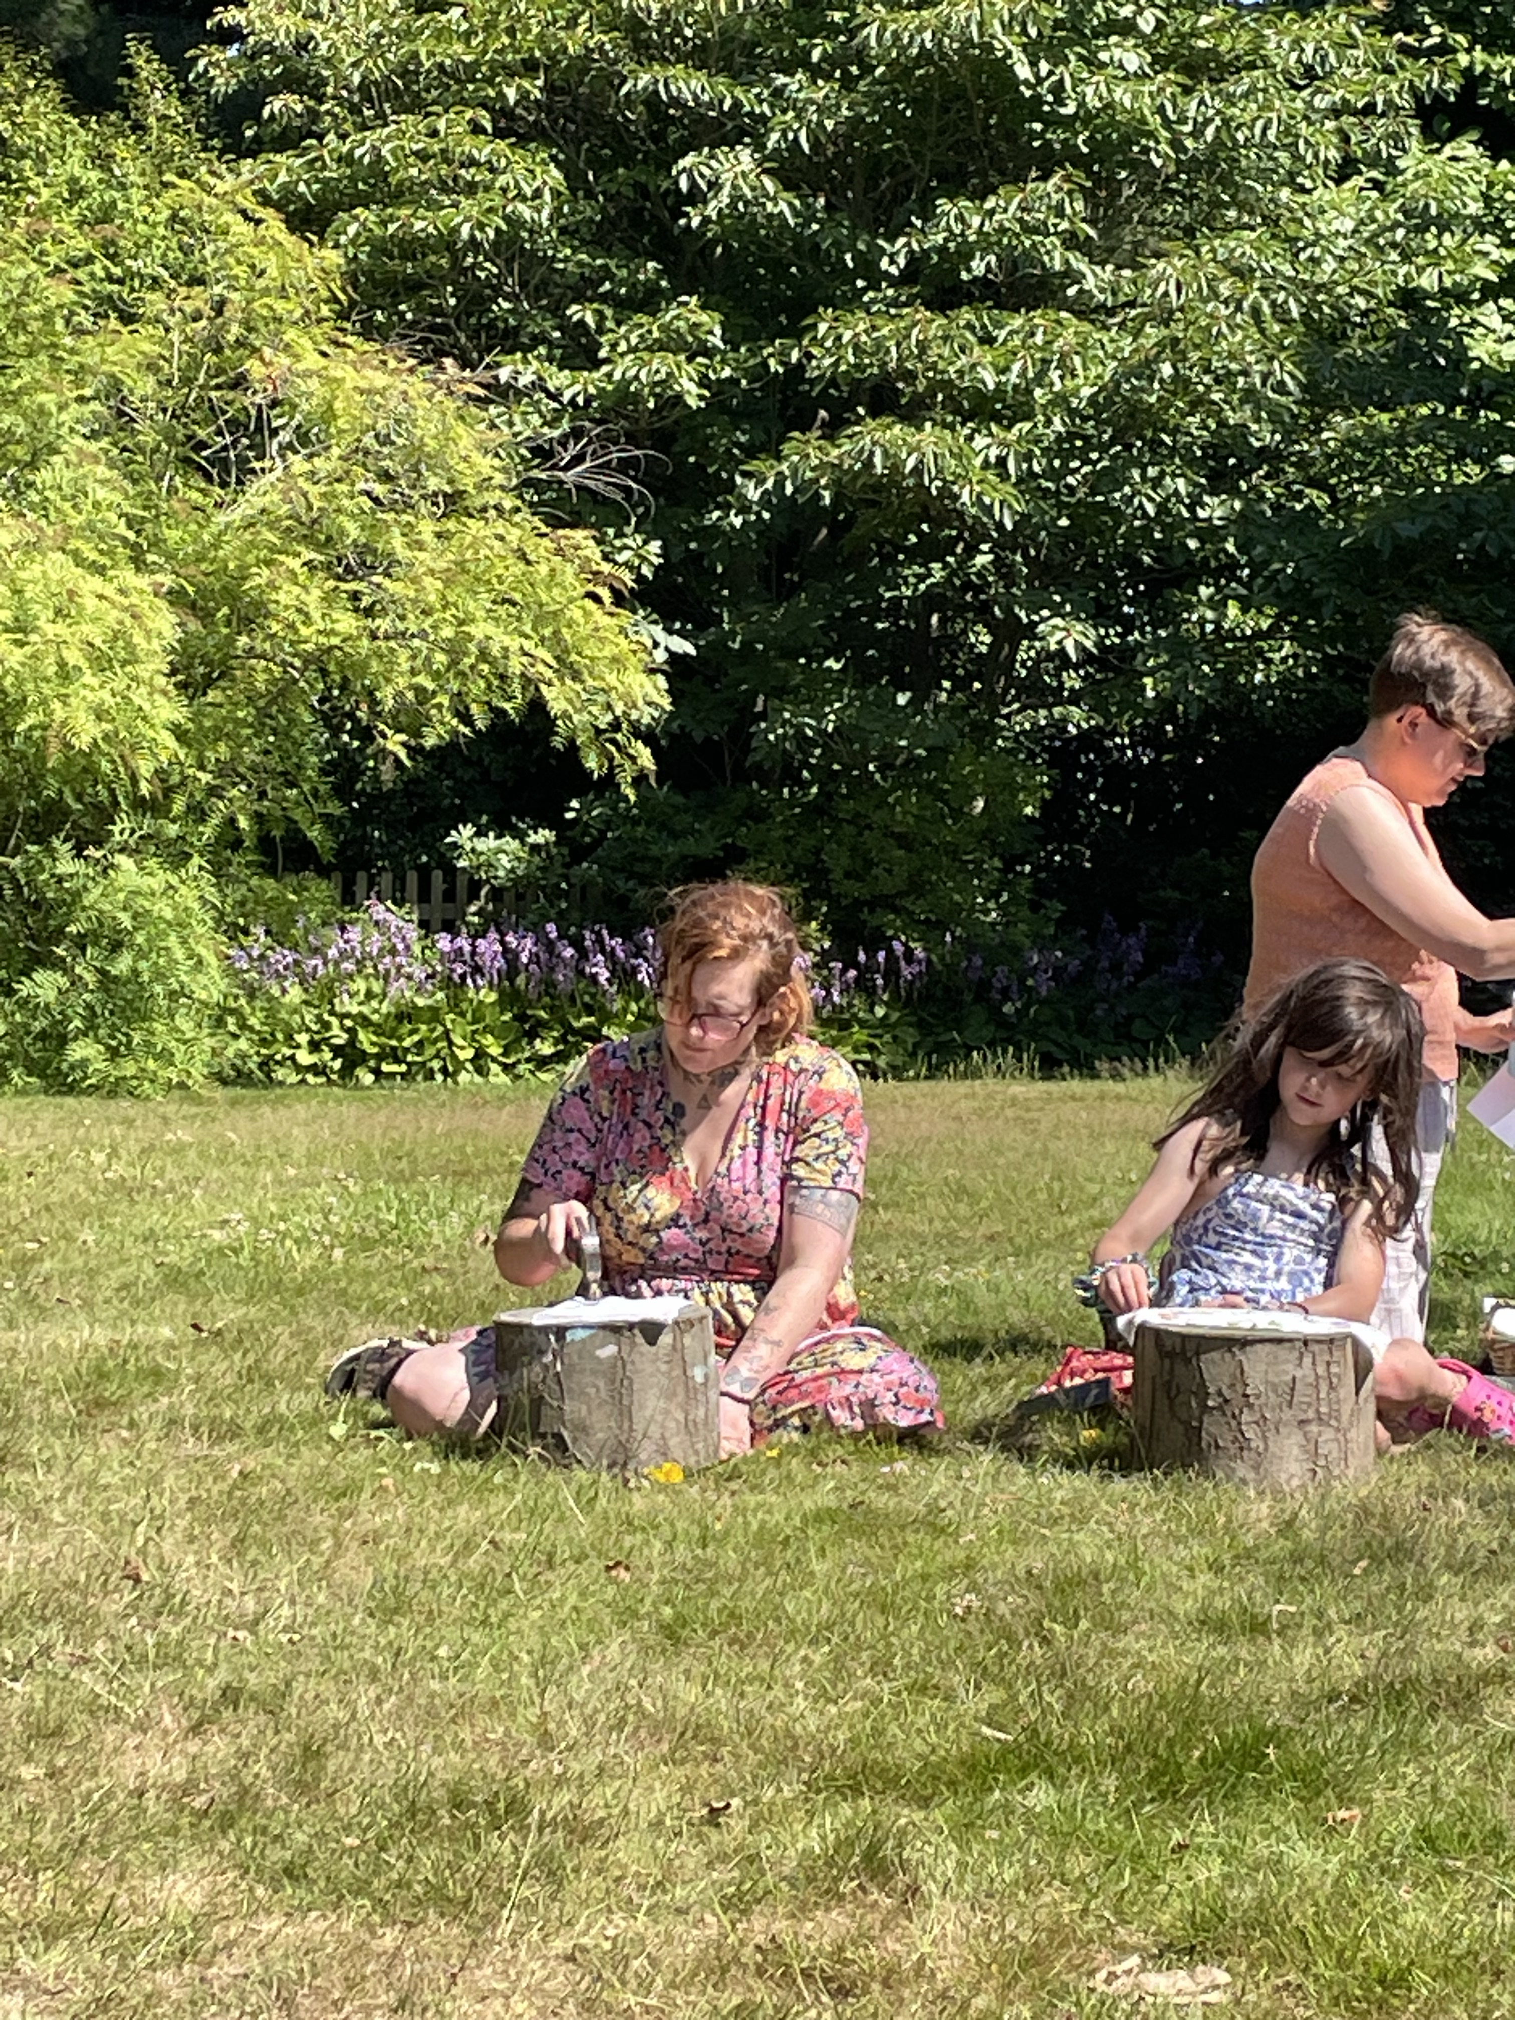

Aspens Services
Young People and Families 2026

Slide 2

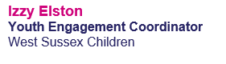
Introductions

Slide 3
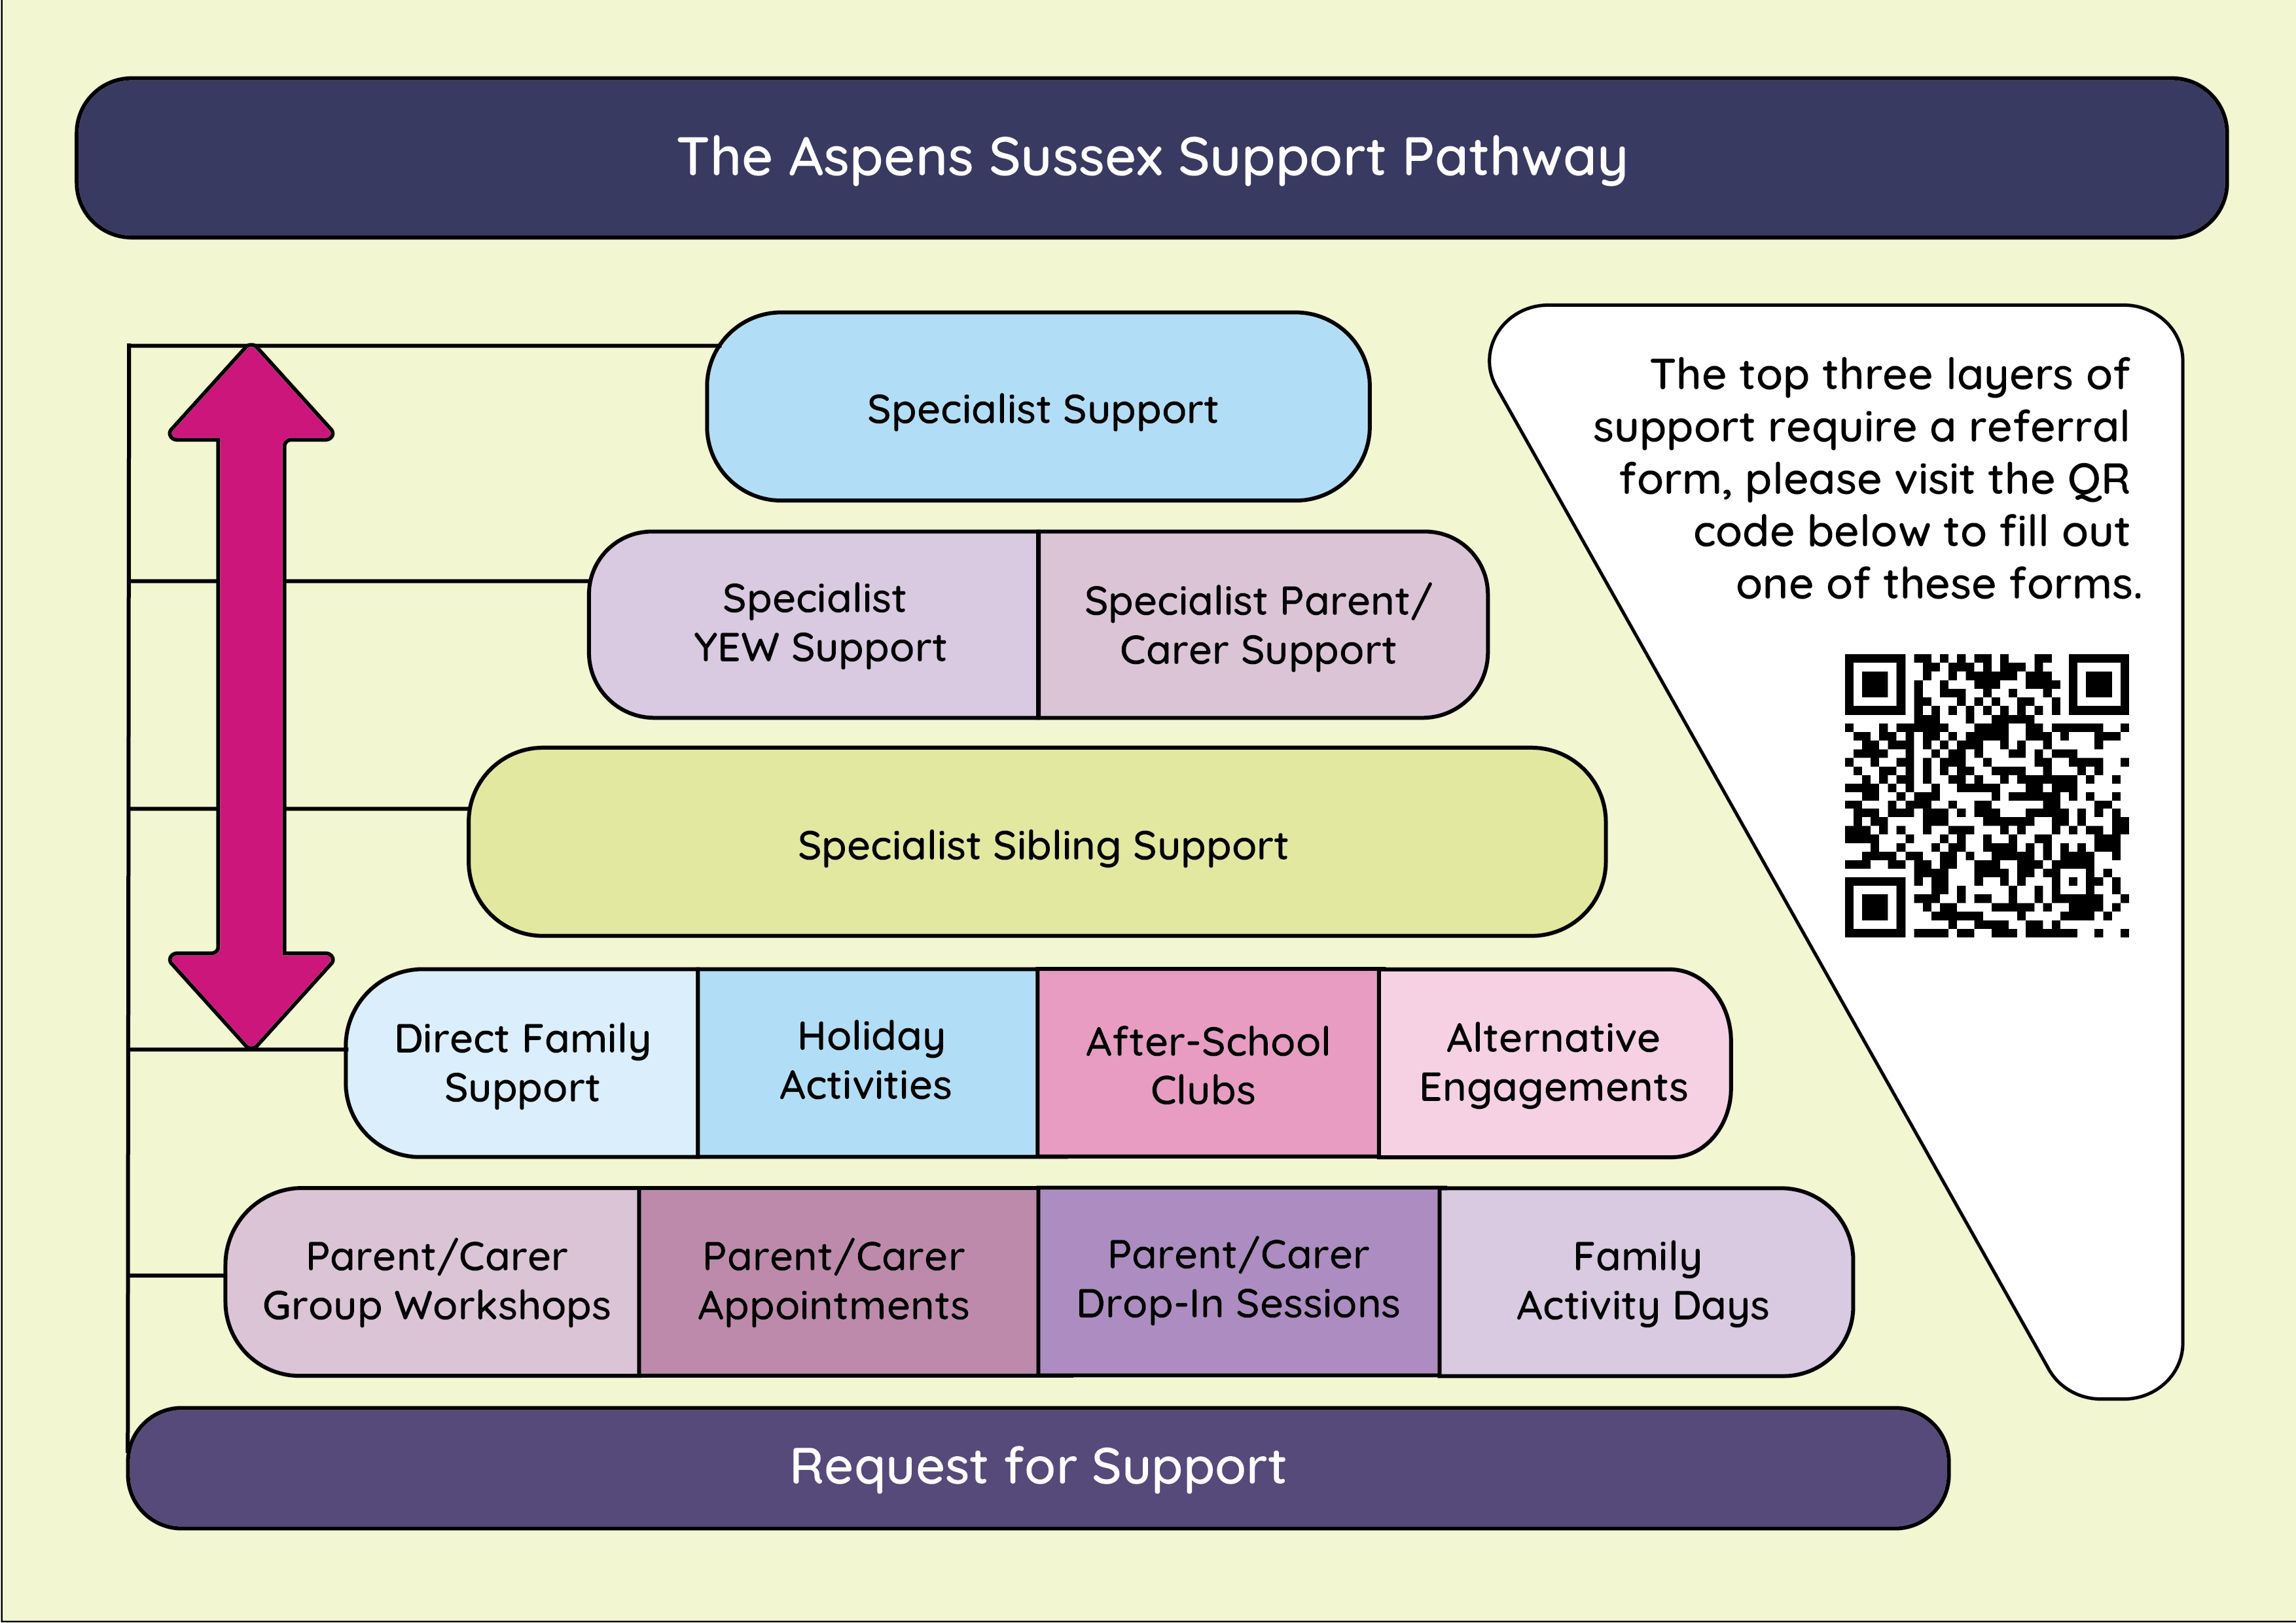
Pathway

Slide 4
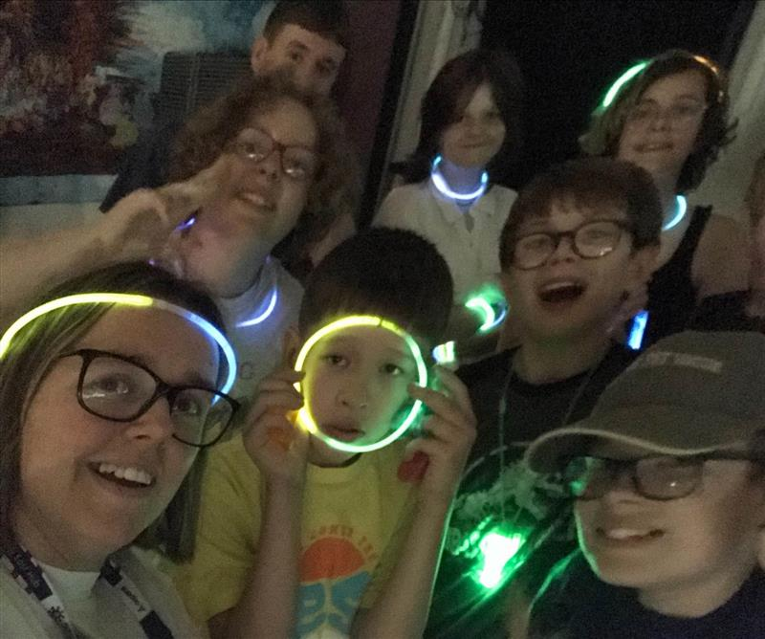
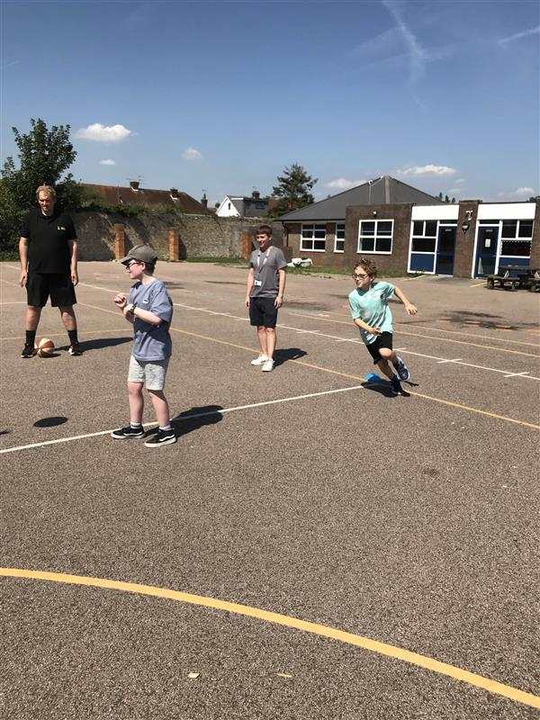
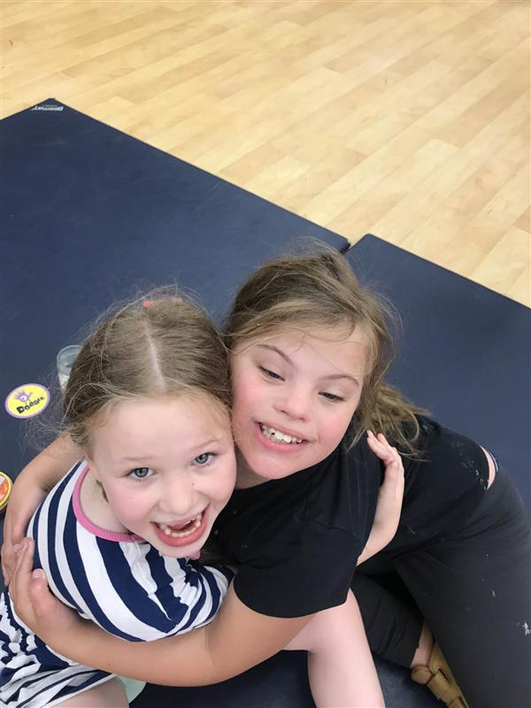
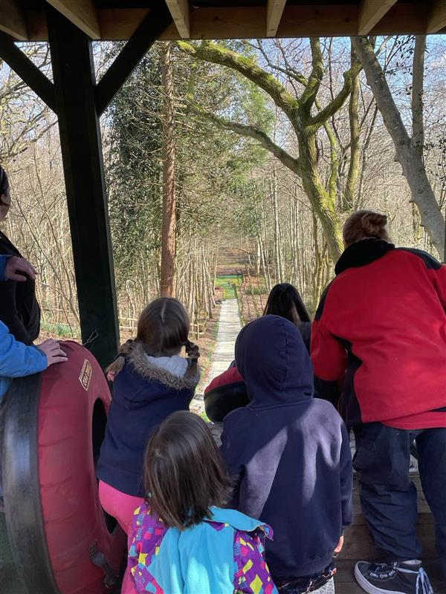
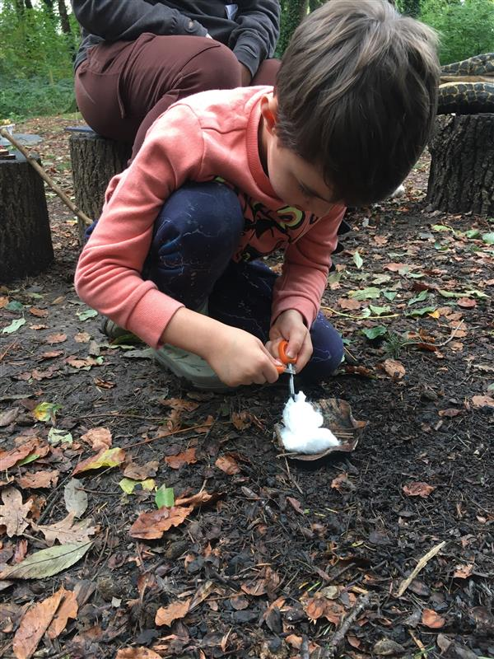
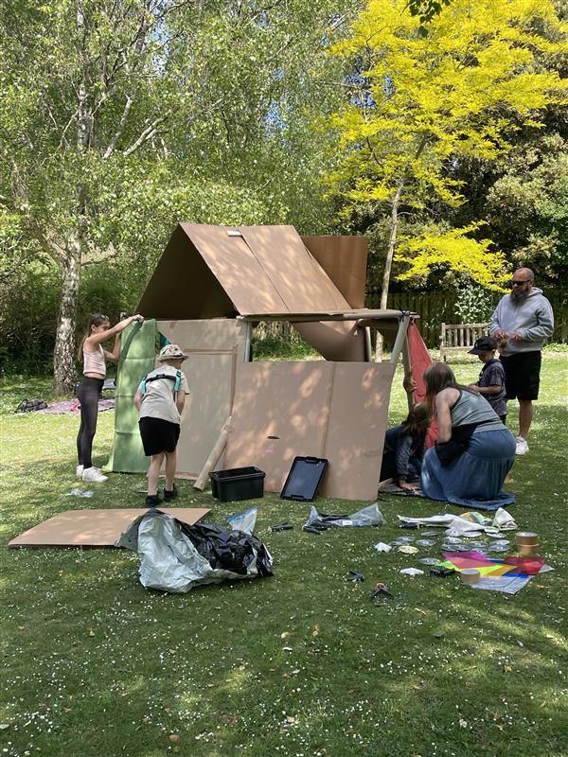
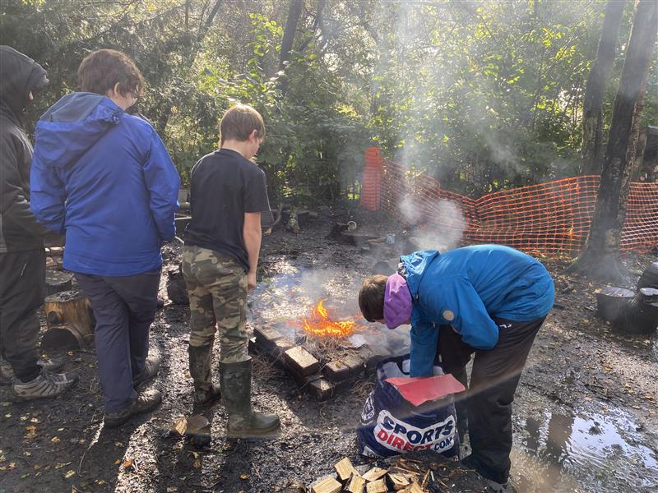
Children’s Services

Slide 5
Children’s Services – age 8 to 18
Schools
Girls Group in Burgess Hill + Worthing (12-17)
School holiday activities across
the county
Youth Club in Arun
Lego Club
D&D
Monthly newsletter

Slide 6
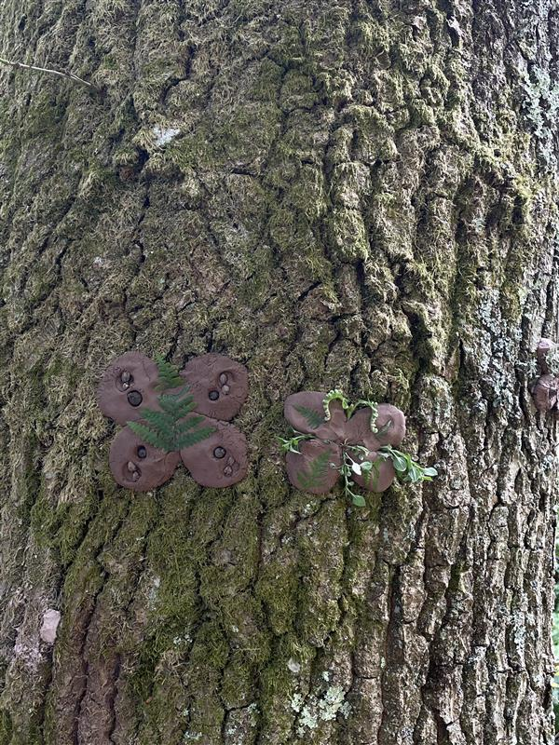
Hybrid Days
We’d like to invite the whole family to activity days where Aspens staff will be right alongside.
After some time spent together as a family, the young person(s) will then be invited to break away from their family groups and continue the activity supported by Aspens staff.
With family members close by, we hope this will enable some young people to take the brave leap of independence and get to know our lovely support team.

Slide 7
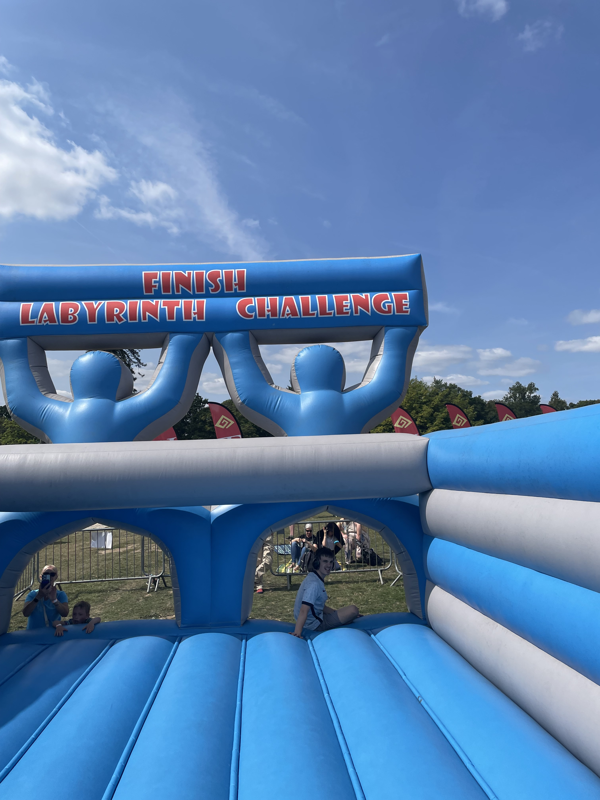
Family Days
Focusing on trying try new things and exploring what West Sussex has to offer.
These days are about creating a sense of community, inclusivity, and empowerment. Families attend events at subsidised rates, giving young people the chance to socialise with peers, and families the opportunity to connect and spend meaningful time together.
We also work in partnership with other providers to extend our reach and showcase the wide range of support available.If anyone is interested in collaborating or creating a bespoke Family Day with Aspens, we’d love to hear from you.

Slide 8
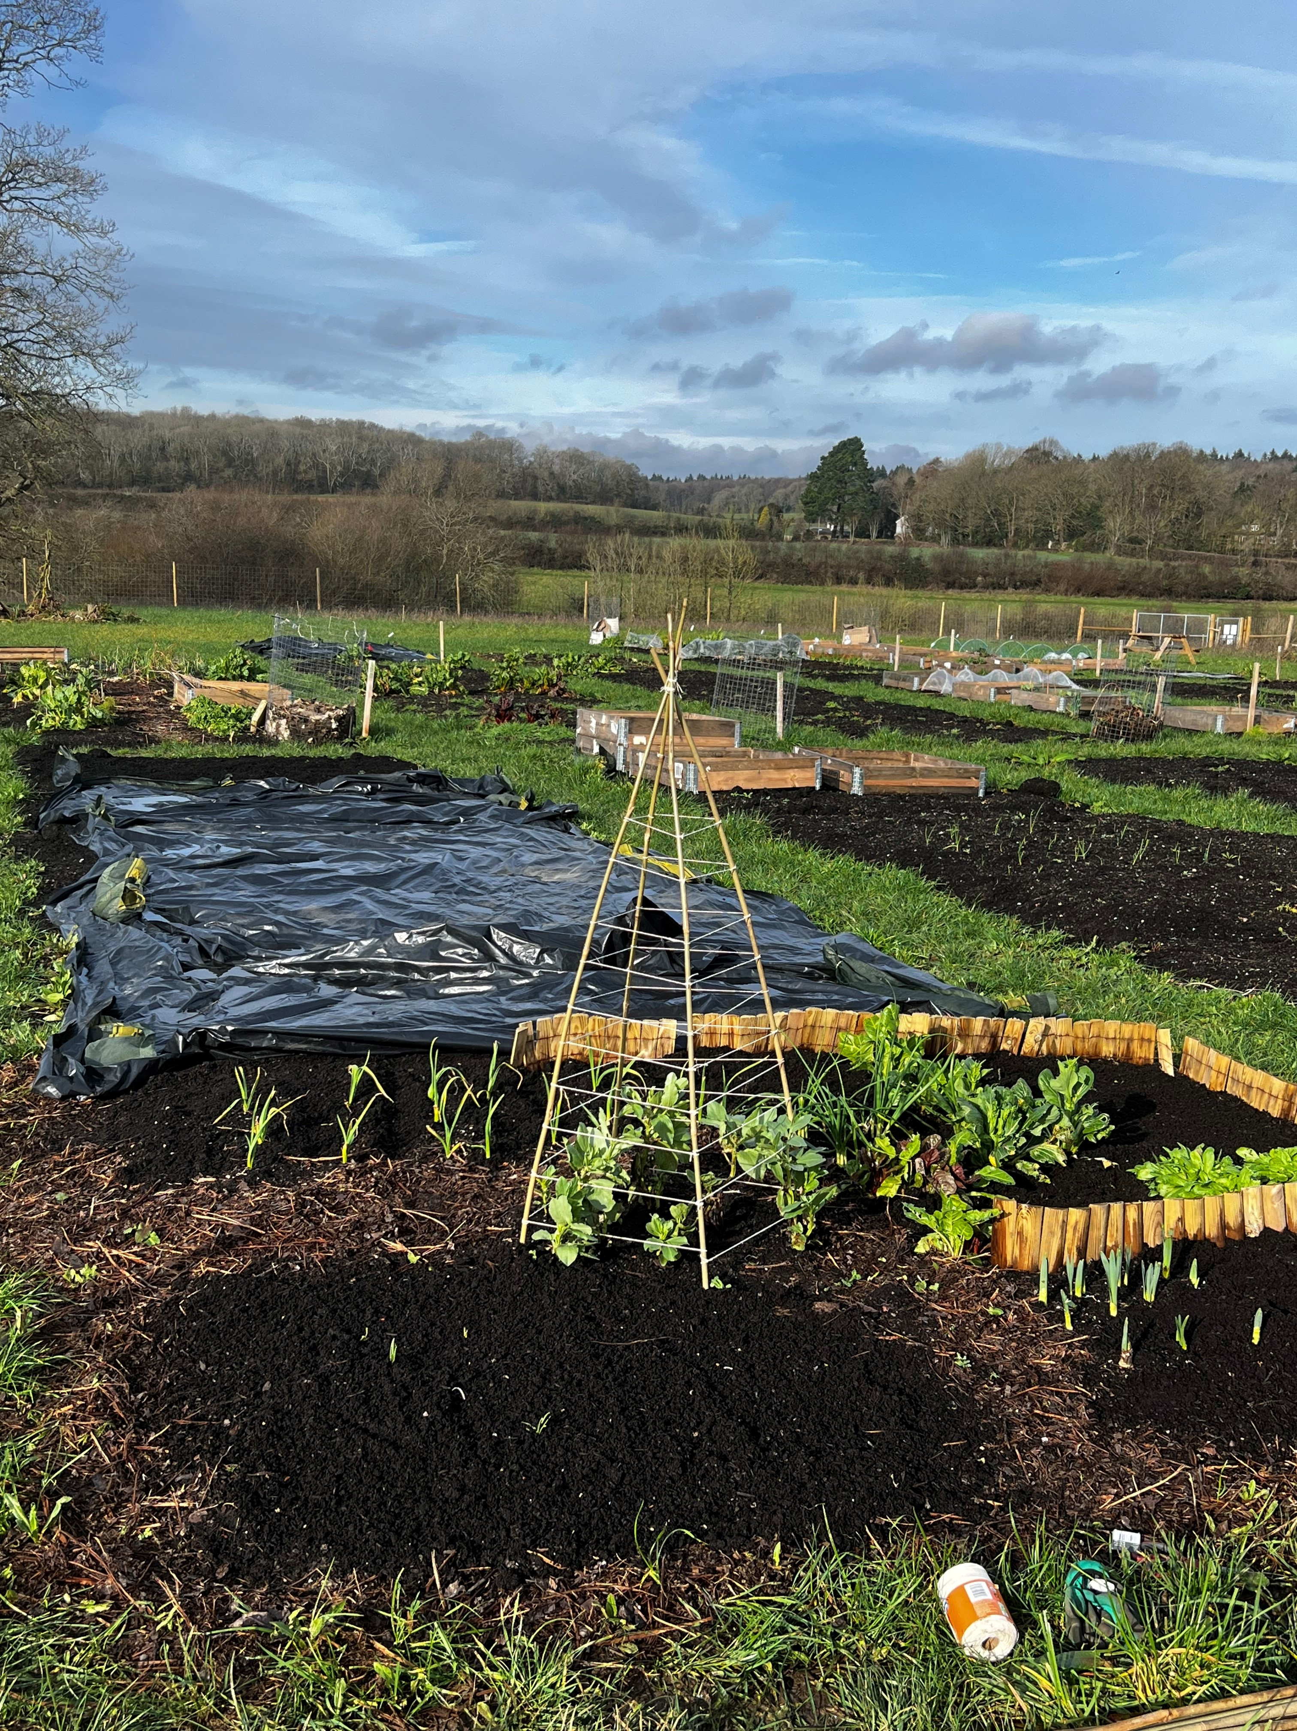
Community Allotment
Our Community Allotment offers the people we support and their families a calm, shared space to connect with nature and each other.
It's a place where we grow fresh produce, learn new skills, and enjoy time outdoors in a supportive and inclusive environment.
We have a grant for this space and we are currently working on making our patch ready for the summer.
Please come and have a chat if you're interested in this space!

Slide 9

Meet the Team
May Half Term - Tuesday 26th May
2x drop-in sessions to meet the team and learn more about What We Do
Mid-Sussex – 10am-12pm, Bentswood @34, 34 America Lane, Haywards Heath, West Sussex, RH16 3QG.
Arun – 2pm-4pm, K2 Youth and Community Centre Eldon Way, Wick, Littlehampton BN17 7HE

Slide 10

Contact Us:
Aspens Get Involved – Fill in form
Scan me now for form to get involved or add comments .
You can email
Izzy: Izzy.Elston@aspens.org.uk
Avia : Avia.Jay@aspens.org.uk
for more information.

Slide 11

Monthly newsletter
https://mailchi.mp/aspens/aspens-west-sussex-newsletter-sign-up
We will never share your data and you can unsubscribe at any point.

Slide 12
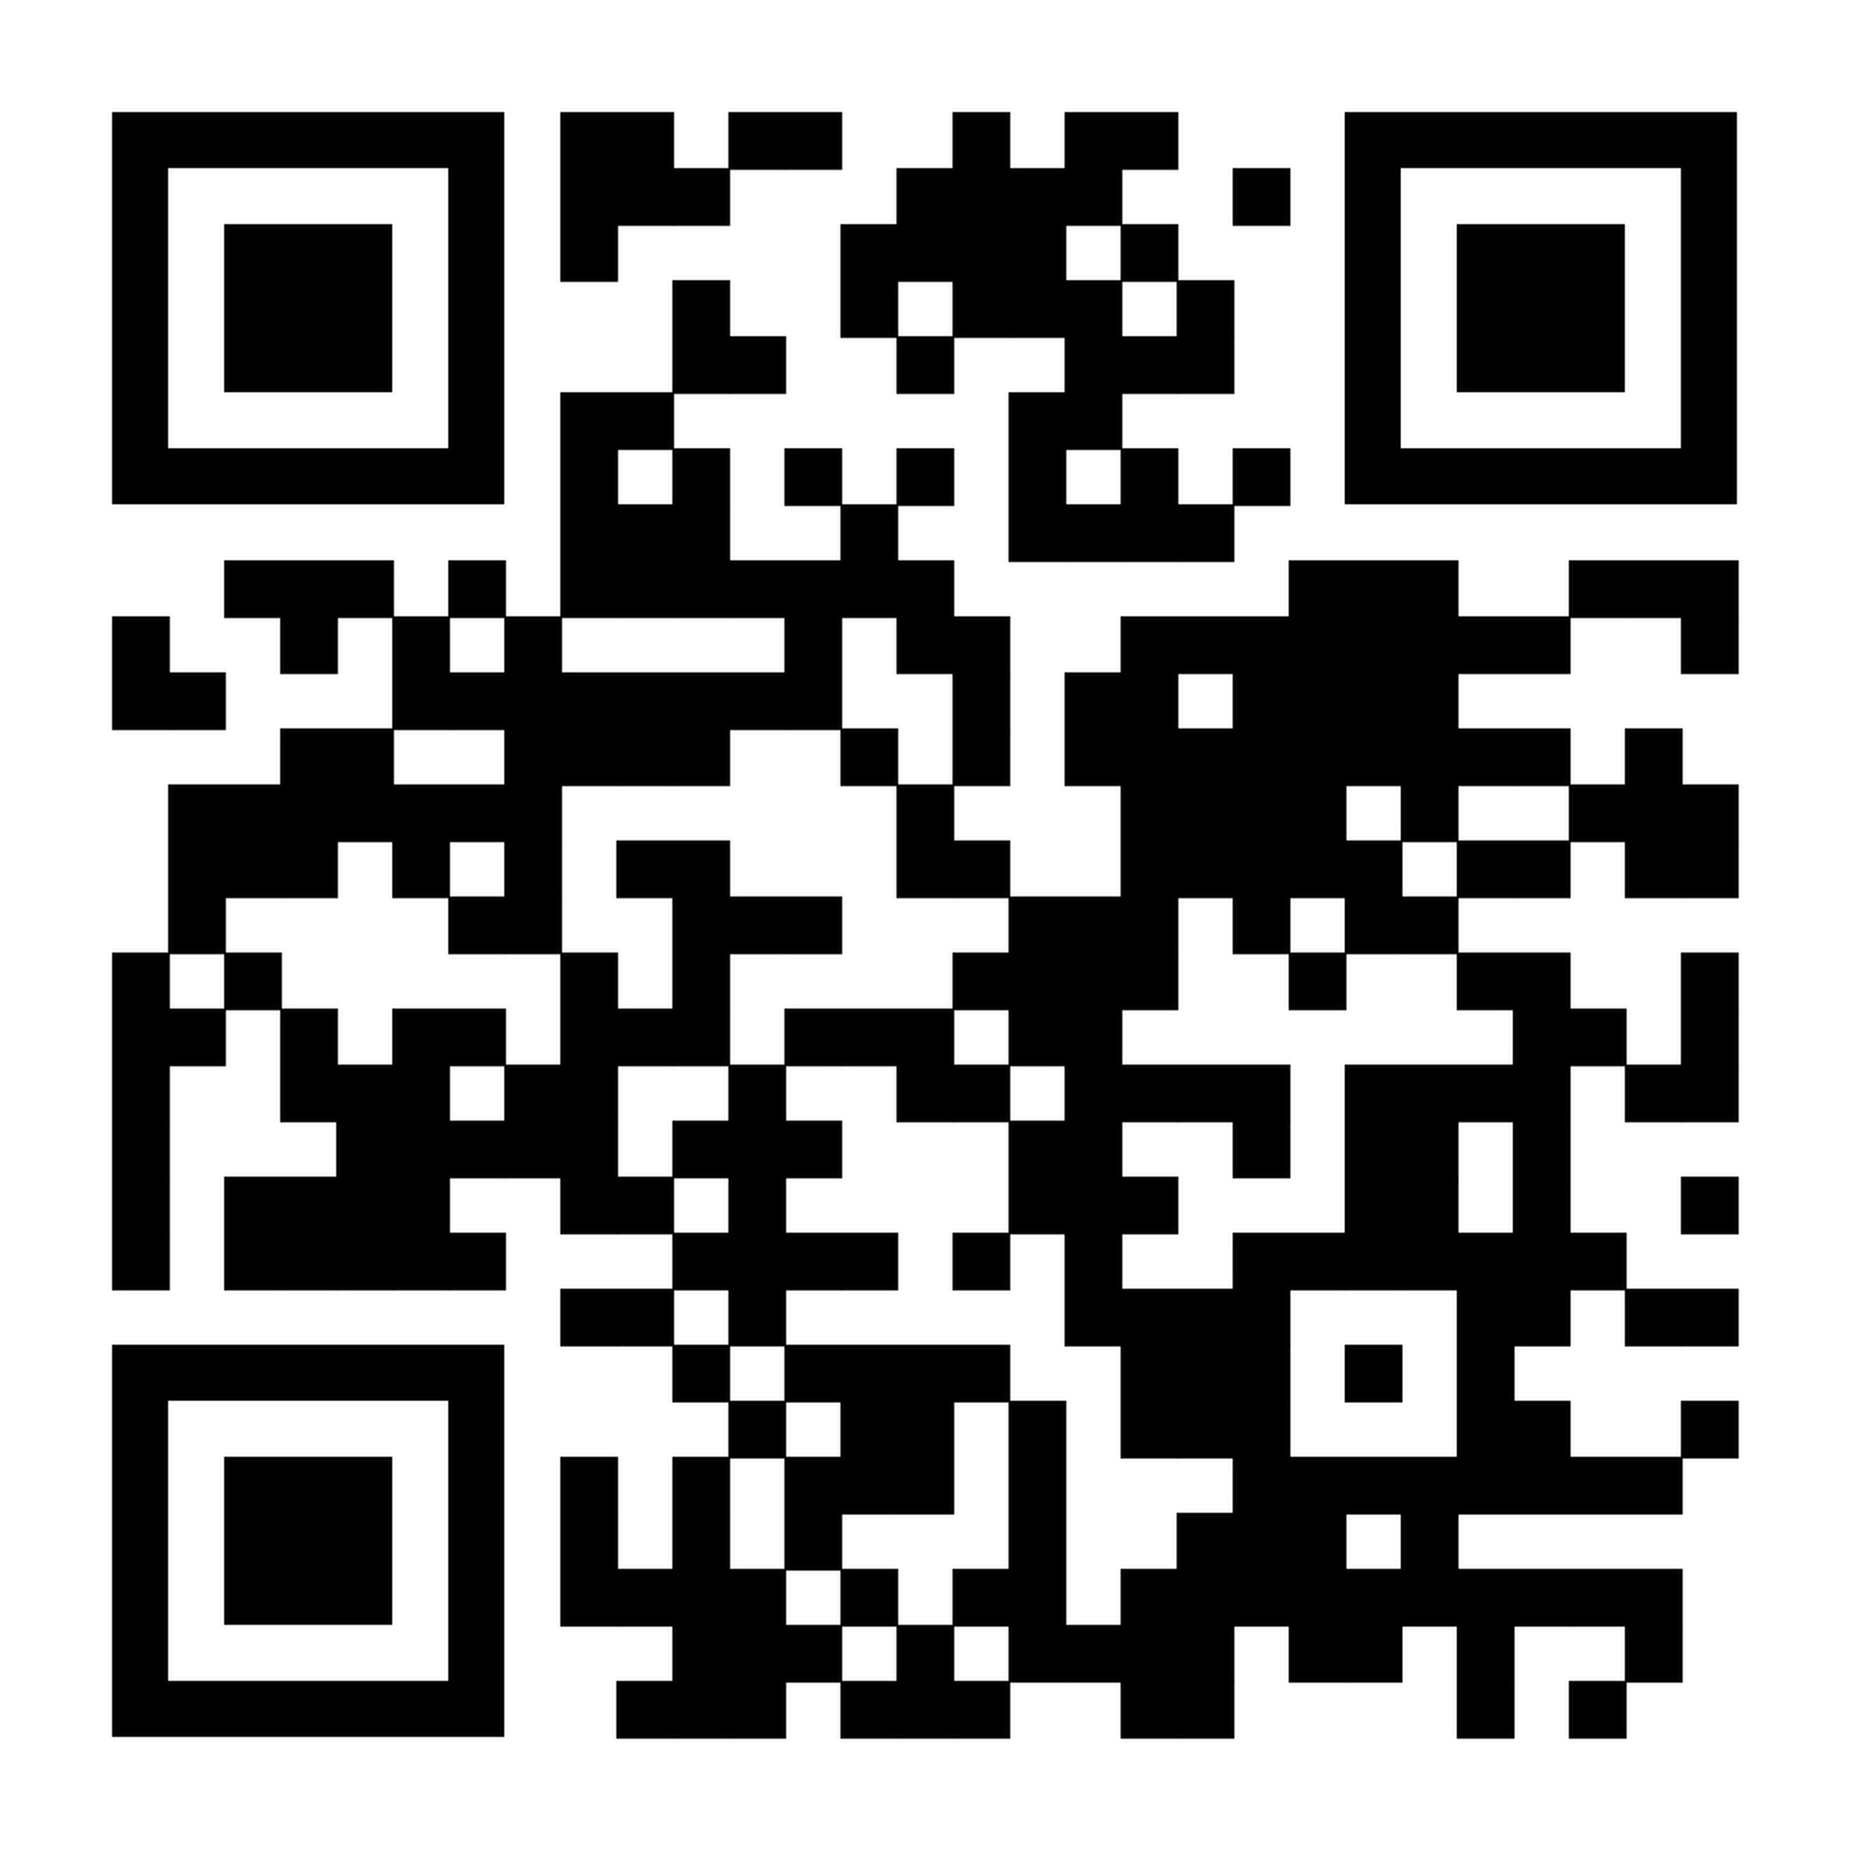
Contact Us:
Bookings – Aspens West Sussex Short Breaks Visit our website via this link to find information about our Family Days and Short Breaks for young people
Scan me now to head to the Bookings page. Alternatively, you can email childrenreferrals@aspens.org.uk for more information.

Slide 13
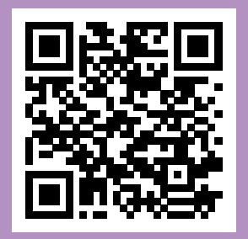
Contact Us:
https://www.aspens.org.uk/request-for-support Visit our website via this link to find contact details and referral forms for Specialist Family Support.
Scan me now to complete a ‘Request for Support’ form and a member of the team will get back to you, to establish the type of support you need.

Slide 14
Contact Us:

